Slide 1

a
Go, change the world
RV College of
Engineering
DEPARTMENT OF COMPUTER SCIENCE AND ENGINEERING
Open Source Simulation Lab (MCN431L)Project Presentation on
‘Implementation of Smart Home Automation System’
Presented By
B A Anirudh Koushik 1RV23SCN01
Pavankumar Patil 1RV23SCN10
Under the guidance of
Dr. Sandya S
Assistant Professor
Department of Computer Science Engineering,
RV College of Engineering, Bengaluru

Slide 2

TABLE OF CONTENTS
Introduction
Problem Statement
Objectives
Design
Methodology
Results & Analysis
References
RV College of
Engineering®
Go, change the world

Slide 3
INTRODUCTION
Internet of things is a network of physical objects used to send, receive communication information using the internet or any other network technology in between the user, manufacturer and other connected devices, which helps in monitoring, coordinating or controlling process across the internet.
IOT has become a revolutionary ecosystem which describes the network of embedded systems and sensors to exchange data over a wired or wireless medium.
IoT based smart home applications have become common since it makes people’s life easier. A smart home comprises of internet-connected equipment with cutting-edge technology which residents can control from distance.
Smart home technology refers to household appliances like lighting, heating, air conditioning, and entertainment systems having key features like comfort, convenience, safety, energy efficiency.
RV College of
Engineering®
Go, change the world

Slide 4
PROBLEM STATEMENT
Design a home automation system that enhances security, convenience, and energy efficiency using components that are capable of automatic light control, smoke detection, motion detection, and controlling appliances such as a fan and door lock mechanism.
RV College of
Engineering®
Go, change the world

Slide 5
OBJECTIVES
To develop a comprehensive system architecture that outlines the integration of all components and sensors.
To develop and debug the software code required to control the automation system.
To integrate the software with the hardware components, ensuring all automated functions work as intended.
RV College of
Engineering®
Go, change the world

Slide 6
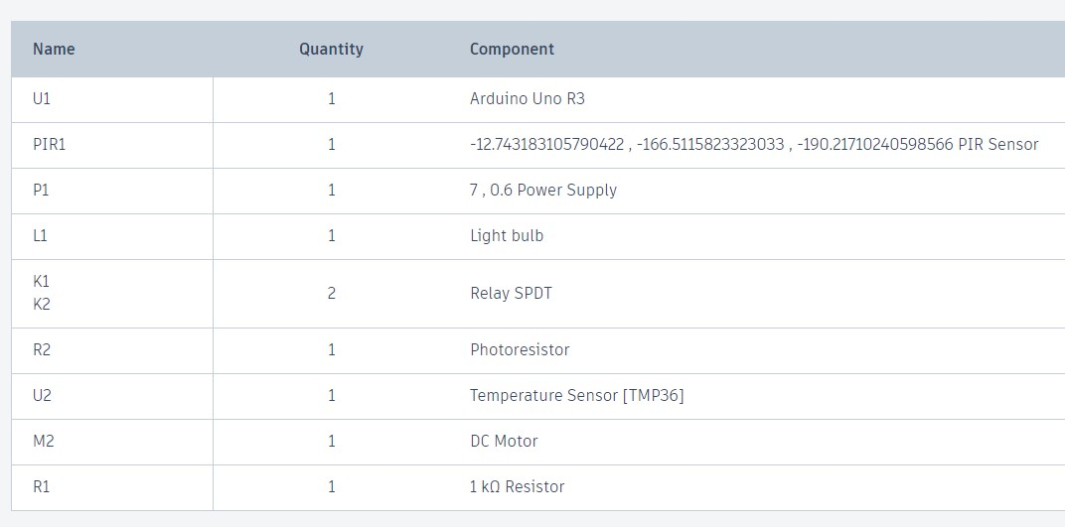
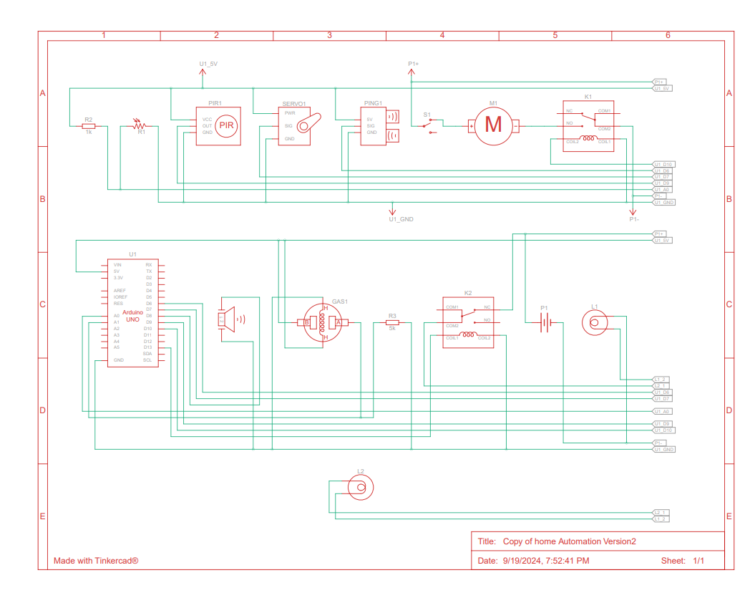
DESIGN
RV College of
Engineering®
Go, change the world
Components for Smart Home Automation System :
Schematic for Smart Home Automation System :

Slide 7
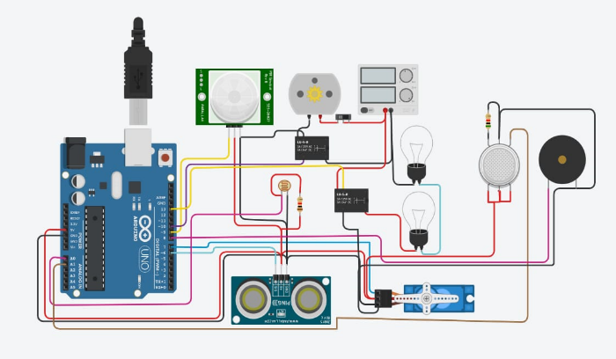
METHODOLOGY
RV College of
Engineering®
Go, change the world
The design incorporates the following:
1. Combining all sensors with an Arduino forms a microcontroller for home automation.
2. Different sensors sense the input and send it to the Arduino to process the input and provide outputs
3. The relay module connects the desired circuit voltage which is high voltage with the Arduino voltage which is a low voltage.
4. The LDR sensor senses the intensity of light and provides input to Arduino.
5. The PIR sensor will sense any motion or movement in home the centralized air-cooling system and lights and ambient lights will be switched on and off.
6. The smoke sensor continuously senses if there is any smoke inside the house, if it detects the fire the buzzer will constantly beep until the smoke is put out.
7. The ultrasonic sensor will help open and close doors automatically based on the detection of distance of objected detected, if the distance is lower than the set distance the door opens else door closes.

Slide 8
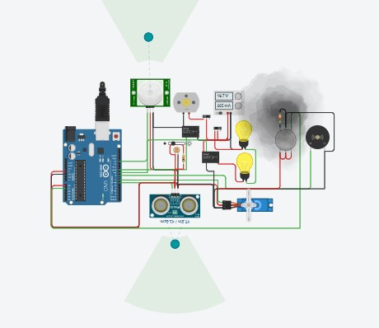
RESULTS & ANALYSIS
RV College of
Engineering®
Go, change the world
Software Model Analysis
proposed software model under simulation. Here, when the system is in simulation mode all the sensors are activated based on its properties. A combination of all these sensors working together help in better coordination between appliances and yield a sophisticated automated experience to the user.

Slide 9
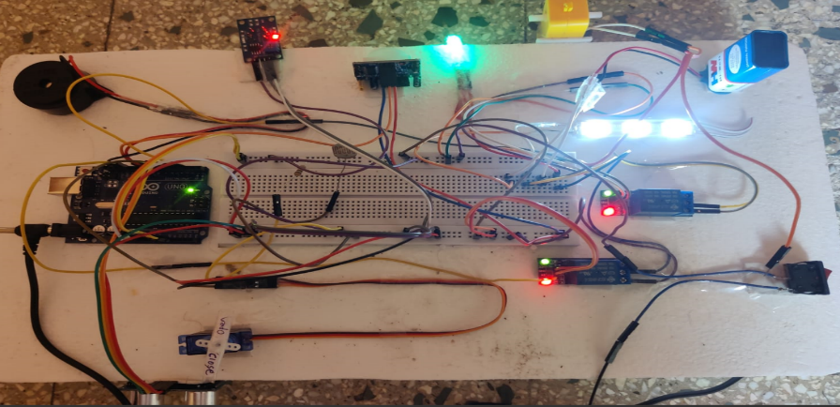
RESULTS & ANALYSIS
RV College of
Engineering®
Go, change the world
Hardware model Analysis
In this setup the Arduino microcontroller manages various sensors and actuators to simulate real-world automation scenarios. The functionalities of various sensors are analyzed:
1.The default distance of the ultrasonic sensor the default is set to 35 cm where when an object distance is closer than 35 cm to the sensors, the automated door opens and closes, the automated door in the model here is represented by a servo motor connected to the ultrasonic sensor. These distances can be modified based on the requirements.
2. The PIR sensor in model which is connected to the LED lights and the motor which supposedly depicts fans and lights acts as a closed circuit only when the sensor detects any motion within the range.

Slide 10
RESULTS & ANALYSIS
RV College of
Engineering®
Go, change the world
3. Similarly, to automate the light intensity and ambience the LDR sensor is are used, initially during the setup a constant value of 400 is assigned to the LDR which can be used as the minimum value of the sensor. The light intensity value of 500 or greater is required for the sensor to operate the light appliances.
4. The smoke sensor is another component which acts as a safety device, initially during setup a constant value is assigned as a threshold value when the sensor reads a value which is greater than the threshold value the buzzer connected starts buzzing for a specified time duration alerting the emergency. Table 2. Summarizes the operation states of a smoke detection unit.
Light intensity | Person in room | Light | Fan
Day | Yes | OFF | ON
Day | No | ON | OFF
Night | Yes | ON | ON
Night | No | OFF | OFF
Smoke Detected | Buzzer/Alarm
Yes | ON
No | OFF
Table 2. Smoke Sensor Operation States
Table 1. LDR Sensor Operation States

Slide 11
References
RV College of
Engineering®
Go, change the world
[1] P. M R and B. Bhowmik, "Development of IoT-Based Smart Home Application with Energy Management," 2023 International Conference on Sustainable Communication Networks and Application (ICSCNA), Theni, India, 2023, pp. 367-373, doi: 10.1109/ICSCNA58489.2023.10370276.
[2] A. Hussien, E. M. J. Evbogbai, H. E. Amhenrior, V. K. Abanihi, L. O. Bello and V. Oisamoje, "Design and Implementation of a Google Assistant Home Automation System," 2022 5th Information Technology for Education and Development (ITED), Abuja, Nigeria, 2022, pp. 1-5, doi: 10.1109/ITED56637.2022.10051454.
[3] Mamta, A. Paul and R. Tiwari, "Smart Home Automation System Based on IoT using Chip Microcontroller," 2022 9th International Conference on Computing for Sustainable Global Development (INDIACom), New Delhi, India, 2022, pp. 564-568, doi: 10.23919/INDIACom54597.2022.9763287.
[4] K. M. Kumar and S. Chaudhury, "Development of a Smart Home Automation System using IoT enabled Devices," 2022 IEEE 19th India Council International Conference (INDICON), Kochi, India, 2022, pp. 1-5, doi: 10.1109/INDICON56171.2022.10040165.
[5] A. Ramkumar, T. Vaigaiselvam, S. Rajendran, S. Saravanavel, A. Kamalesh and K. Rajesh, "Android Controlled Smart Home Automation with Security System," 2022 2nd International Conference on Advance Computing and Innovative Technologies in Engineering (ICACITE), Greater Noida, India, 2022, pp. 1245-1249, doi: 10.1109/ICACITE53722.2022.9823575.

Slide 12
RV College of
Engineering®
Go, change the world
THANK YOU

